Slide 1
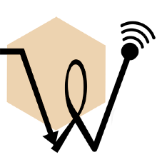
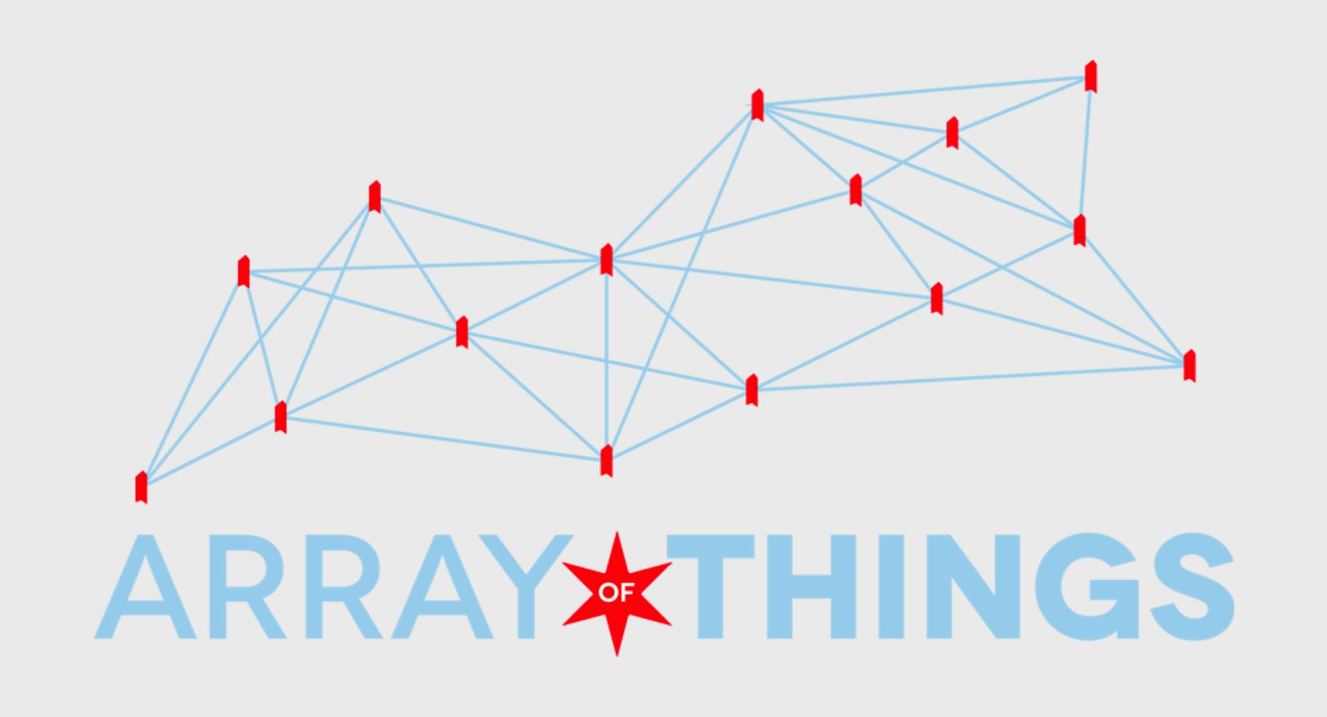
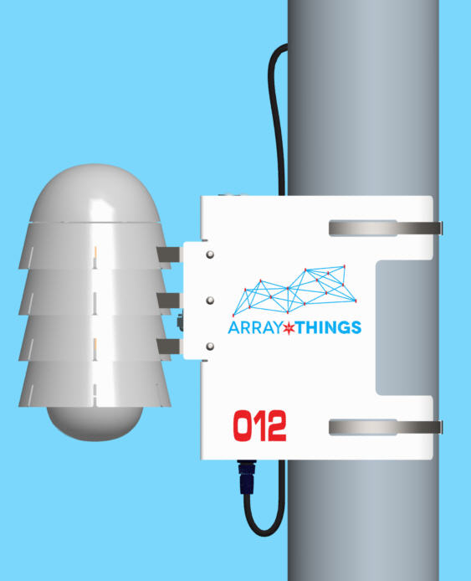
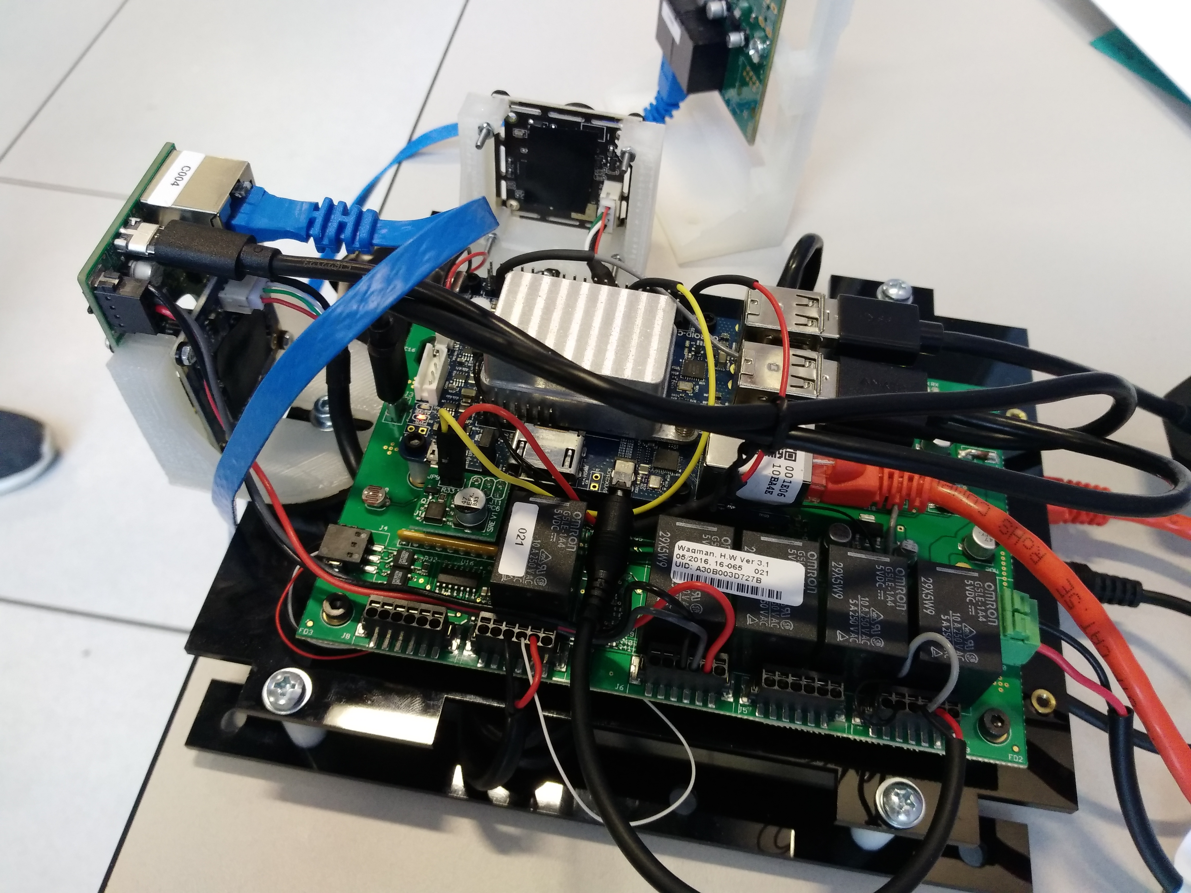
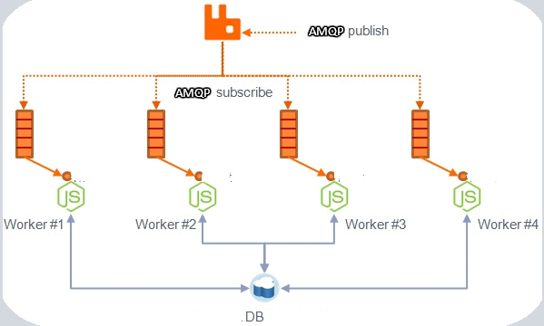


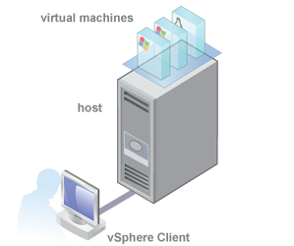

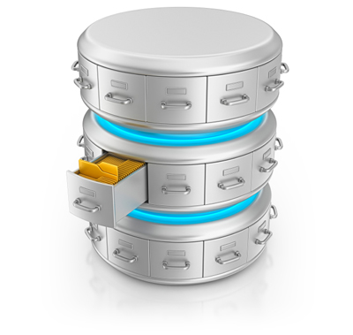
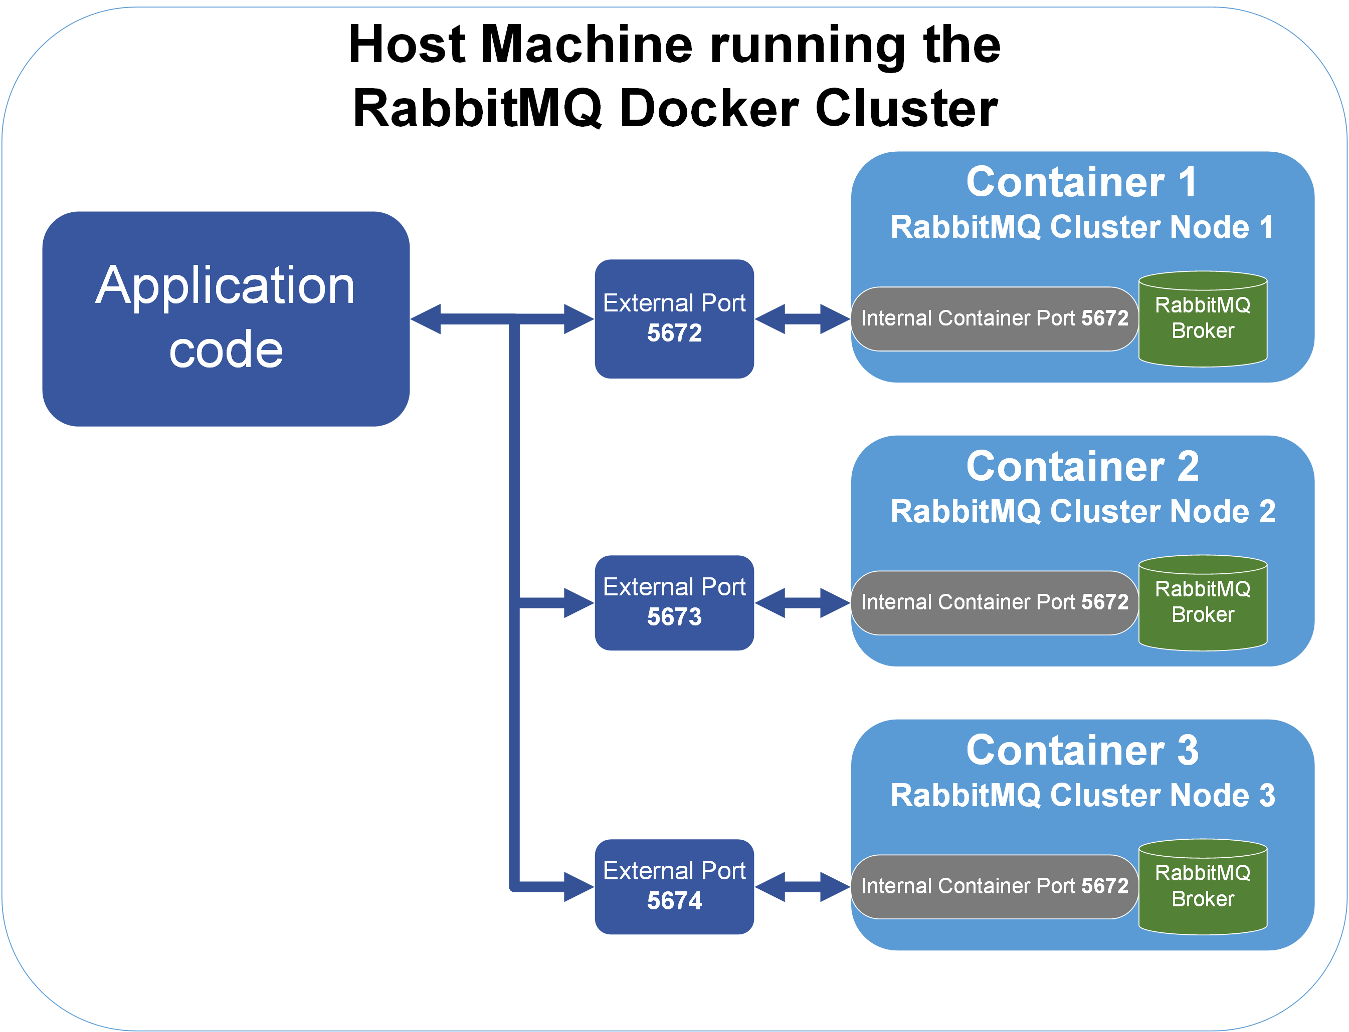
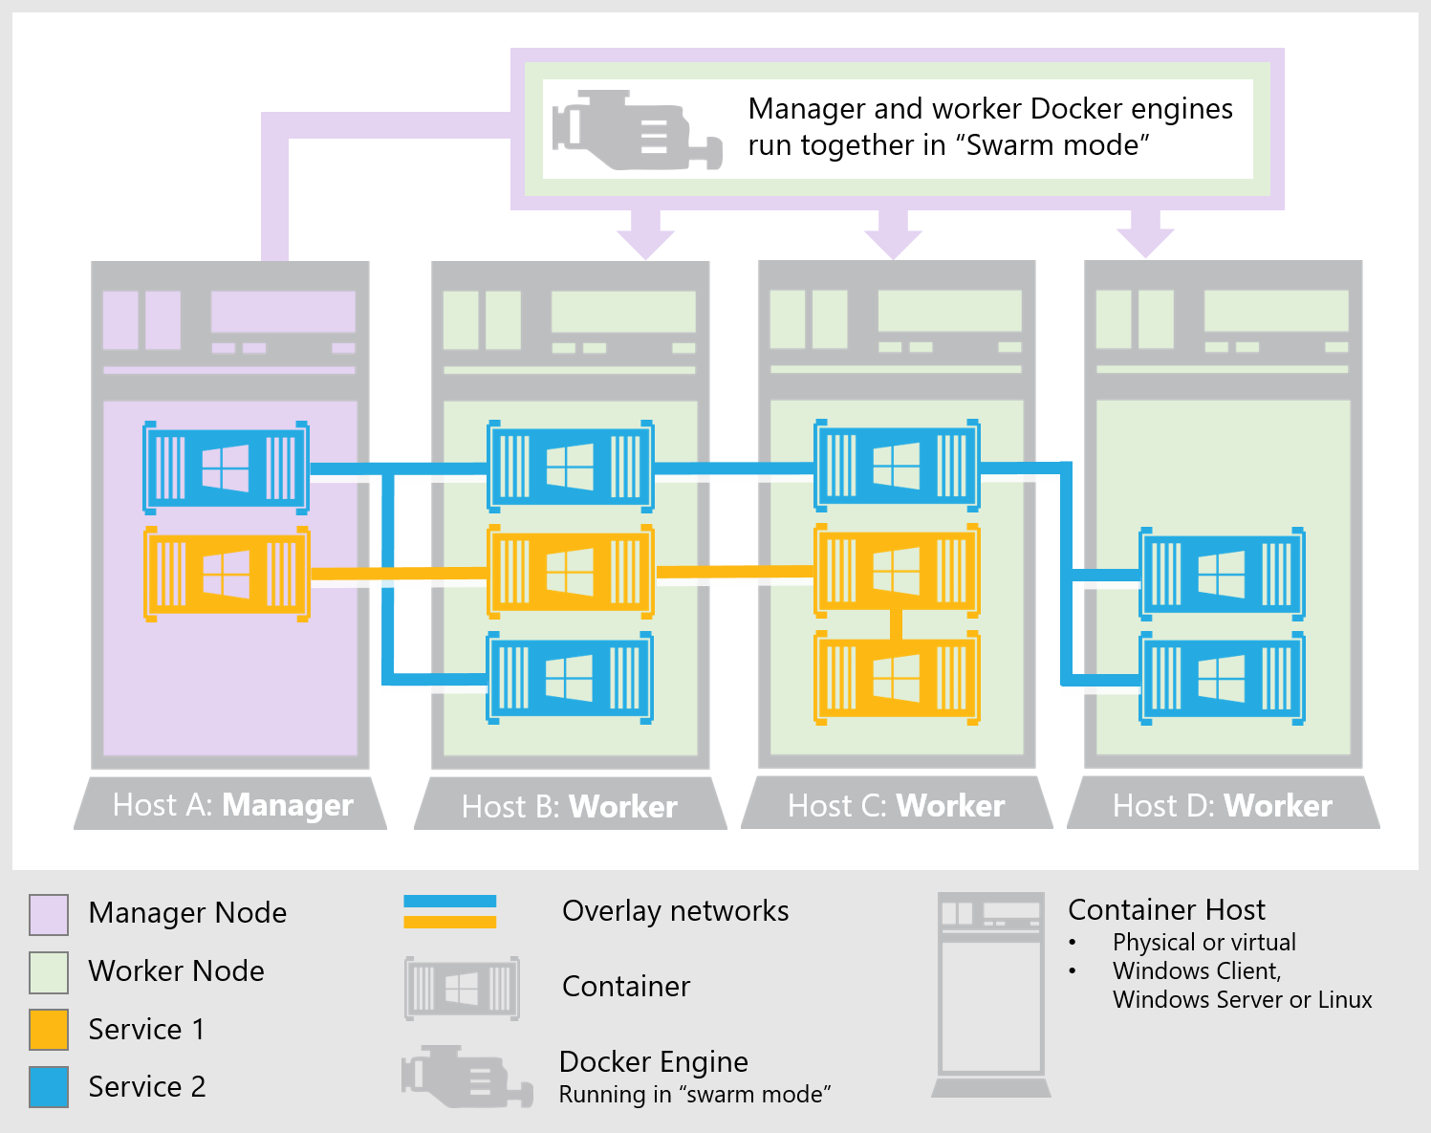
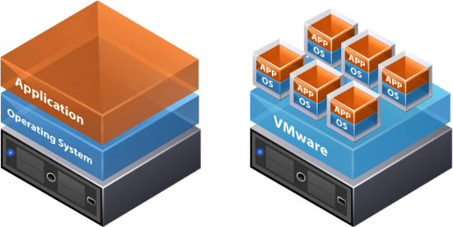
VIRTUAL NODE ENVIRONMENT for the Waggle Attentive Sensing Platform
Saikiran Yerraguntla
Argonne National Laboratory: Mathematics and Computer Science Division
Supervisors: William Catino, Peter Lane, Sean Shakarami
Abstract
The creation and production of numerous nodes can be expensive, time-consuming and tough to scale. However, vital objectives such as plugin development, automated software testing, stress-testing the server are inhibited without using existing hardware pieces of the node.
Thus, replicas of these nodes are created virtually for testing and experimental purposes. The environment that allows the creation, testing, and deployment of these virtual nodes, to an infinite number, is the Virtual Node Environment.
AOT NODE
Compute Brain of AOT/Waggle Node
Data Pipeline
In order to test certain software via virtual nodes and observe how the data is parsed through the server and outputted to a web-interface, various plugins clients must be set up to process such data formulated by the software.
The Node-side Plugin queries sensors, cloud-platforms, and other data sources. Further, it decodes the respective raw data and sends it to waggle’s cloud database platform, Beehive, to be published in Beehive’s Web Data Portal.
The Server-side Plugin, situated in Beehive, retrieves the raw data from the node-side plugin, processes it, and publishes the output to Beehive’s Web Data Portal.
This interaction is a messaging exchange service that takes place in RabbitMQ.
STEP 1:
STEP 3:
Host Machine
Beehive
Beehive Data Portal
Docker Containers and the Virtual Node Environment
Containers are open-source platforms meant to virtually run programs. In the project, the containers were created to serve as the virtual nodes.
These containers were created to run as proxies for software plugins.
Containers can be replicated infinitely to run numerous instances of virtual nodes. This is to constantly stress-test Waggle’s Beehive server.
One such application used for testing purposes of these containers is being able to virtually run “Coresense Chips” and “Thermistor sensors” to observe how the containers process and send the data coming from these data hubs.
The Application used for the formation & deployment of the Virtual Environment: “Docker”.
STEP 2:
Final Purposes:
The creation and establishment of these virtual nodes has laid a foundation to set proxies to run software plugins virtually, create a swarm of multitude of nodes, stress-test the Waggle server, lay a basis to further creation of more virtual nodes, and automate software testing.
Developing further software infrastructure that will create microservices to deploy virtual nodes in numerous containers.
Creating QEMU Emulator for Node Emulation.
Future Directions:

